Slide 1
Module 7
Basic Data Visualization Techniques

Slide 2
Contents
• Creating a scatterplot
• Adding a regression line to a scatterplot
• Plotting categories
• Labeling the graph
• Legend layouts
• Creating a facet
• Theming
• Creating bar charts
• Creating violin plots
• Creating density plots

Slide 3
Basic Data Visualization Techniques
The ggplot2 package is a library that enables the creation of many types of data visualization including various types of charts and graphs.
This library was first created by Hadley Wickham in 2005 and is an R implementation of Leland Wilkinson’s Grammar of Graphics.
The idea behind this package is to specify plot building blocks and then combine them to create a graphical display.
Building blocks of ggplot2 include data, aesthetic mapping, geometric objects, statistical transformations, scales, coordinate systems, position adjustments, and faceting.

Slide 4
Basic Data Visualization Techniques (cont….)
There are a number of advantages to using ggplot2 versus other visualization techniques available in R.
These advantages includes:
consistent style for defining the graphics
high level of abstraction for specifying plots
flexibility
built-in theming system for plot appearance
mature and complete graphics system
access to many other ggplot2 users for support.

Slide 5
Creating a scatterplot
A scatterplot is a graph in which the values of two variables are plotted along two axes, with the pattern of the resulting points revealing any correlation present.
Exercise 1:
Load readr, dplyr, ggplot2 packages. – Make sure the Working Directory is set.
Load StudyArea.csv file into data frame.
dfWildfires <- read_csv("StudyArea.csv", col_types = list(UNIT = col_character()), col_names = TRUE)

Slide 6
Exercise 1 (cont…)
3. Create a subset of columns.
df <- select(dfWildfires, ORGANIZATI, STATE, YEAR_, TOTALACRES, CAUSE)
4. Group the records by year.
grp <- group_by(df, YEAR_)
5. Summarize the data by total number of acres burned.
sm <- summarize(grp, totalacres = sum(TOTALACRES))
6. Use ggplot() to create a scatterplot with the YEAR_ on the x axis and the
totalacres burned on the y axis.
ggplot(data=sm) + geom_point(mapping = aes(x=YEAR_, y=totalacres))

Slide 7
Exercise 1 (cont…)
7. There are times when it makes sense to use the logarithmic scales in
charts and graphs.
One reason is to respond to skewness towards large values, i.e, cases in which one or a few points are much larger than the bulk of the data.
Create the graph by using the log() function on the totalacres column.
ggplot(data=sm) + geom_point(mapping = aes(x=YEAR_, y=log(totalacres)))

Slide 8
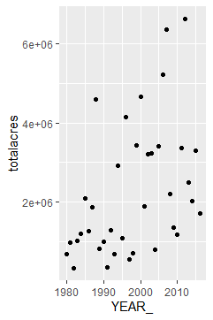
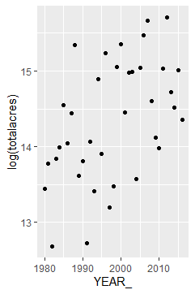
Step 6
Step 7

Slide 9
Adding a regression line to the scatterplot
Plots constructed with ggplot() can have more than one geometry. It’s common to add a prediction (regression) line to the plot.
Exercise 2:
There are several ways that can add a regression line to the scatterplot, one of which is to use the geom_smooth() function with the method set to lm (straight line) and the se parameter set to FALSE.
ggplot(data=sm, aes(x=YEAR_, y=log(totalacres))) + geom_point() + geom_smooth(method=lm, se=FALSE)

Slide 10
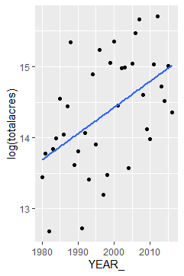
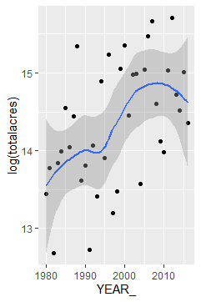
Exercise 2 (cont….)
3. You can add a confidence interval around the regression line by
setting se = TRUE.
ggplot(data=sm, aes(x=YEAR_, y=log(totalacres))) + geom_point() + geom_smooth(method=loess, se=TRUE)
Step 3
Step 2

Slide 11
Plotting Categories
Rather than graphing the entire set of wildfires you might want to better understand the trends by state.
Create a new scatterplot that visualizes wildfires trends over time by state.
Exercise 3:
1. Regroup the wildfires data frame by state and year.
grp <- group_by(df, STATE, YEAR_)
2. Summarize the groups by total acres burned.
sm <- summarize(grp, totalacres = sum(TOTALACRES))

Slide 12
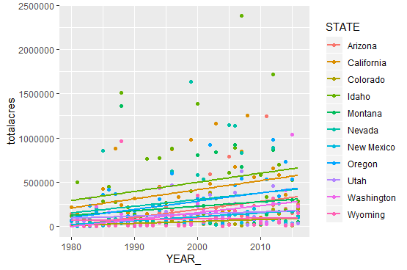
Exercise 3 (cont…)
3. Add a colour parameter to the aes() function so that the points and
regression line are mapped according to the state in which they
occurred.
ggplot(data=sm, aes(x=YEAR_, y=totalacres, colour=STATE)) + geom_point(aes(colour = STATE)) + stat_smooth(method=lm, se=FALSE)

Slide 13
Labeling the graph
You can add labels to your graph through either the geom_text() function or the geom_ label() function.
Exercise 4:
Label each of the points on the scatterplot using geom_text() with a label size of 3.
ggplot(data=sm, aes(x=YEAR_, y=log(totalacres))) + geom_point() + geom_smooth(method=loess, se=TRUE) + geom_text(aes(label=STATE),size=3)

Slide 14
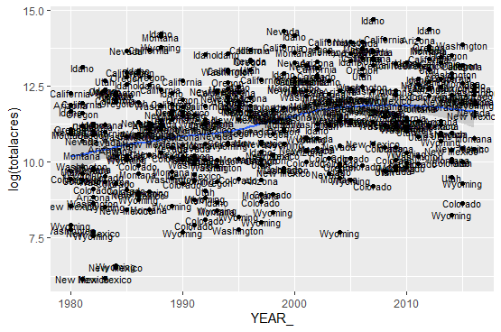

Slide 15
Exercise 4 (cont…)
The display is extremely cluttered so let’s adjust a few parameters to make this easier to read.
2. You can use the check_overlap parameter to remove any overlapping labels.
ggplot(data=sm, aes(x=YEAR_, y=log(totalacres))) + geom_point() + geom_smooth(method=loess, se=TRUE) + geom_text(aes(label=STATE), size=3, check_overlap = TRUE)

Slide 16
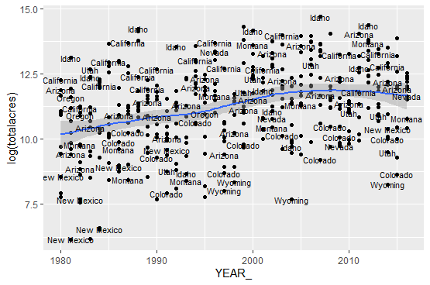
Exercise 4 (cont…)

Slide 17
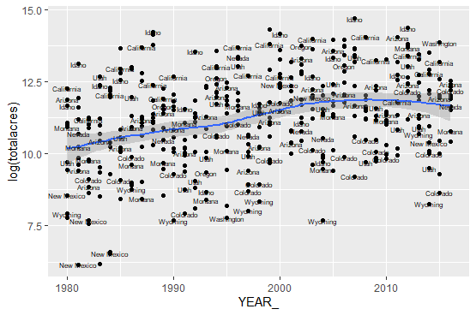
Exercise 4 (cont…)
3. This look quite a bit better but if you change the label size to 2 it will
further reduce the clutter and overlapping while hopefully still being
readable.

Slide 18
Exercise 4 (cont…)
4. Notice that the labels sit directly on top of the topics. You can use the
nudge_x and nudge_y parameters to move the labels relative to the
point.
ggplot(data=sm, aes(x=YEAR_, y=log(totalacres))) + geom_point() + geom_smooth(method=loess, se=TRUE) + geom_text(aes(label=STATE), size=2, check_overlap = TRUE, nudge_x = 1.0)
5. You can also color the labels by category by adding the color
parameter to the aes() for geom_text().
ggplot(data=sm, aes(x=YEAR_, y=log(totalacres))) + geom_point() + geom_smooth(method=loess, se=TRUE) + geom_text(aes(label=STATE, color=STATE), size=2, check_overlap = TRUE, nudge_x = 1.0)

Slide 19
Exercise 4 (cont…)
6. Add a subtitle and caption with the code you see below,
ggplot(data=sm, aes(x=YEAR_, y=log(totalacres))) + geom_point() + geom_smooth(method=loess, se=TRUE) + labs(title=paste("Acreage Burned by Wildfires Has Increased In the Past Few Decades"), subtitle=paste("1980-2016"), caption="Data from USGS")
7. You can also update the X and Y labels for the graph. Update these labels on your graph using the code you see below.
ggplot(data=sm, aes(x=YEAR_, y=log(totalacres))) + geom_point()+geom_smooth(method=loess,se=TRUE)+labs(title=paste("Acreage Burned by Wildfires Has Increased In the Past Few Decades"),subtitle=paste("1980-2016"), caption="Data from USGS") + scale_y_continuous(name="Log of Total Acres Burned") + scale_x_continuous(name="Burn Year")

Slide 20
Legend layouts (START)
The theme() function can be used to control the location of the legend and the guides() function can be used to provide additional legend control.
Exercise 5:
The theme() function along with the legend.postion argument is used to control the location of the legend on the graph. By default, the legend we’ve seen so far has been placed on the right side of the graph with a vertical orientation. Reposition the legend to the bottom with the code below.
ggplot(data=sm, aes(x=YEAR_, y=log(totalacres), color=STATE)) +geom_point() + labs(title=paste("Acreage Burned by Wildfires Has Increased In the Past Few Decades"), subtitle=paste("1980-2016"), caption="Data from USGS") + scale_y_continuous(name="Log of Total Acres Burned") + scale_x_continuous(name="Burn Year") + theme(legend.position="bottom")

Slide 21
Exercise 5 (cont… )
2. You can also explicitly remove a legend by setting
legend.position = "none".
3. Other aspects of the legend such as the number of rows in the
legend as well as the symbol size can be control through the
guides() function.
ggplot(data=sm, aes(x=YEAR_, y=log(totalacres), color=STATE)) + geom_point() + labs(title=paste("Acreage Burned by Wildfires Has Increased In the Past Few Decades"), subtitle=paste("1980-2016"), caption="Data from USGS") + scale_y_continuous(name="Log of Total Acres Burned") + scale_x_continuous(name="Burn Year") + theme(legend.position = "bottom") + guides(color=guide_legend(nrow=2,override.aes=list(size=4)))

Slide 22
Creating a facet
A particularly good way of graphing categorical variables is to split your plot into facets, which are subplots that each display one subset of the data. The facet_wrap() and facet_grid() function can be used to create facets.
Exercise 6:
Use the facet_wrap() function displayed in the code below to create a facet map that displays total acres burned by state.
ggplot(data=sm, mapping = aes(x=YEAR_, y=log(totalacres))) + geom_point()+ facet_wrap(~STATE) + geom_smooth(method=loess, se=TRUE)

Slide 23
Theming
ggplot2 includes 8 builtin themes that can be used to cutomize the stying of the non-data elements of plot.
Exercise 7:
The eight themes included in ggplot2 are theme_bw, theme_ classic, theme_dark, theme_gray, theme_light, theme_ linedraw, theme_minimal, theme_void.
ggplot(data=sm, mapping = aes(x=YEAR_, y=log(totalacres))) + geom_point()+ facet_wrap(~STATE) + geom_smooth(method=loess, se=TRUE) + theme_dark()

Slide 24
Creating bar charts
geom_bar() or geom_chart() can be used to create bar charts with ggplot2.
The geom_bar() function will generate a count of the number of instances of a variable. In other words, it changes the statistic that has already been generated for the group.
The geom_col() function keeps the variable already generated for the group.
Exercise 8:
Load the StudyArea.csv file and get a subset of columns.
dfWildfires <- read_csv("StudyArea.csv", col_types = list(UNIT = col_character()), col_names = TRUE)
df <- select(dfWildfires, ORGANIZATI, STATE, YEAR_, TOTALACRES, CAUSE)

Slide 25
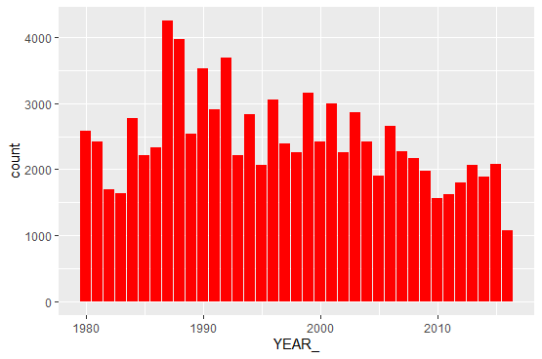
Exercise 8 (cont…)
Filter the data frame so that only wildfires for California are included. df <- filter(df, STATE == 'California')
Group the data frame by YEAR_. grp <- group_by(df, YEAR_)
Plot the data using geom_bar() as seen below. Notice that the bar chart that is produced is a count of the number of fires for each year.
ggplot(data=grp) + geom_bar(mapping = aes(x=YEAR_), fill="red")

Slide 26
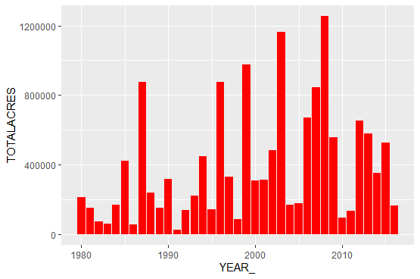
Exercise 8 (cont…)
Now use geom_col() to see the difference. The TOTALACRES variable is maintained in this case.
ggplot(data=grp) + geom_col(mapping = aes(x=YEAR_, y=TOTALACRES), fill="red")

Slide 27
Creating Violin Plots
Violin plots, which are similar to box plots, also show the probability density at various values.
Thicker areas of the violin plot indicate a higher probability at that value.
Typically, violin plots also include a marker for the median along with the Inter-Quartile Range (IQR).
The geom_violin() function is used to create violin plots in ggplot2
Exercise 9:
Load the StudyArea.csv file and get a subset of columns.
dfWildfires <- read_csv("StudyArea.csv", col_types = list(UNIT = col_character()), col_names = TRUE)
df <- select(dfWildfires, ORGANIZATI, STATE, YEAR_, TOTALACRES, CAUSE)

Slide 28
Exercise 9 (cont…)
Filter the data frame so that only wildfires greater than 5000 acres are included.
dfWildfires <- filter(dfWildfires, TOTALACRES>=5000)
Group the wildfires by organization.
grpWildfires <- group_by(dfWildfires, ORGANIZATI)
4. Create a basic violin plot.
ggplot(data=grpWildfires, mapping = aes(x=ORGANIZATI, y=log(TOTALACRES))) + geom_violin()

Slide 29
Exercise 9 (cont…)
You can add the individual observations using geom_jitter().
ggplot(data=grpWildfires, mapping = aes(x=ORGANIZATI, y=log(TOTALACRES))) + geom_violin() + geom_jitter(height = 0, width = 0.1)
6. The mean can be added using stat_summary() as seen below.
ggplot(data=grpWildfires, mapping = aes(x=ORGANIZATI, y=log(TOTALACRES))) + geom_violin() + geom_jitter(height = 0, width = 0.1) + stat_summary(fun.y=mean, geom="point", size=2, color="red")

Slide 30
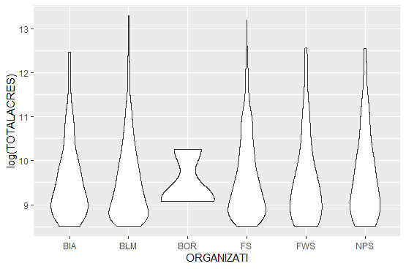
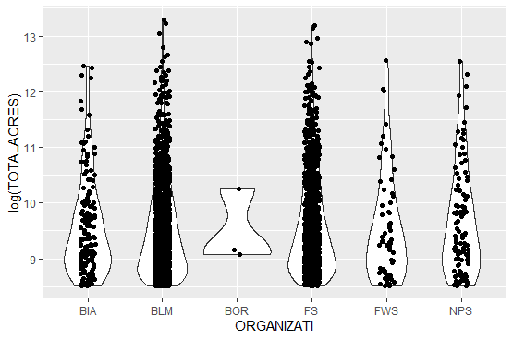
Step 4
Step 5

Slide 31
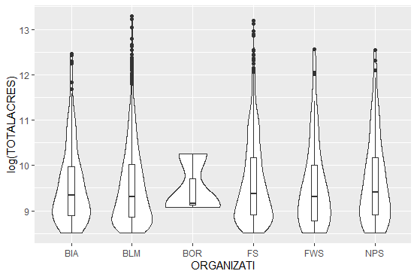
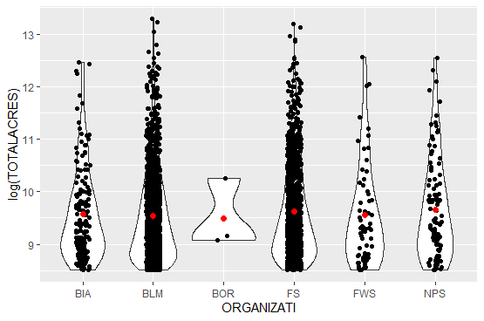
Exercise 9 (cont…)
7. The box_plot() function can be used to add the mean and IQR.
ggplot(data=grpWildfires, mapping = aes(x=ORGANIZATI, y=log(TOTALACRES))) + geom_violin() + geom_boxplot(width=0.1)
Step 7
Step 6
"

Slide 32
Creating Density Plots
Density plots, created with geom_density() computes a density estimate, which is a smoothed version of a histogram and is used with continuous data.
ggplot2 can also compute 2D versions of density includes contours and polygon styled density plots.
Exercise 10:
Load the StudyArea.csv file and get a subset of columns.
dfWildfires <- read_csv("StudyArea.csv", col_types = list(UNIT = col_character()), col_names = TRUE)
df <- select(dfWildfires, ORGANIZATI, STATE, YEAR_, TOTALACRES, CAUSE)

Slide 33
Exercise 10 (cont…)
Filter the data frame so that only wildfires greater than 1000 acres are included.
dfWildfires <- filter(dfWildfires, TOTALACRES>=1000)
Create a density plot with the geom_density() function.
ggplot(dfWildfires, aes(TOTALACRES)) + geom_density()
4. Create the same density plot with a logged version of the data.
ggplot(dfWildfires, aes(log(TOTALACRES))) + geom_density()

Slide 34
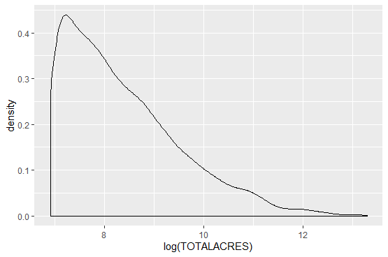
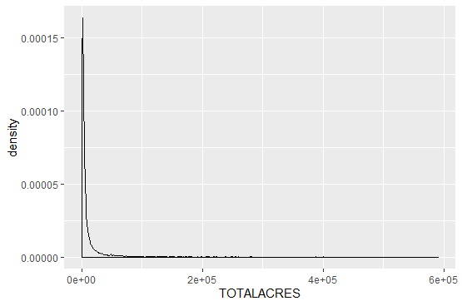
Step 3
Step 4

Slide 35
Exercise 10 (cont…)
Create 2D plots of the data starting with contours.
ggplot(dfWildfires, aes(x=YEAR_, y=log(TOTALACRES))) + geom_point() + geom_density_2d()
6. Finally, create a 2D density surface using stat_density_2d().
ggplot(dfWildfires, aes(x=YEAR_, y=log(TOTALACRES))) + geom_density_2d() + stat_density_2d(geom="raster", aes(fill=..density..), contour=FALSE)

Slide 36
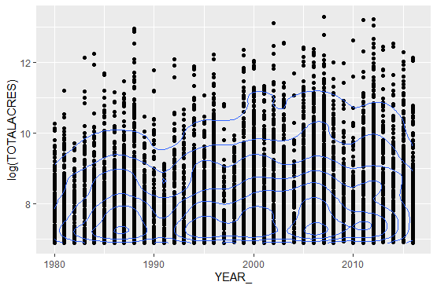
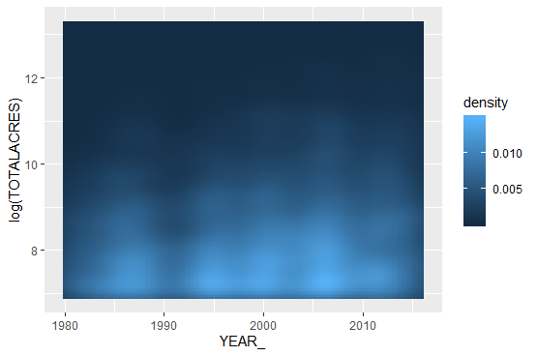
Step 5
Step 6

